Slide 1






CAPSTONE PROJECT REPORT
A comprehensive analysis of demographic, behavioral, and medical history factors associated with heart disease risk
Heart Disease Prediction
319,795 Records
19 Variables
Machine Learning
Prepared By
William C. Phiri
PG Dip in Data Science
Student No. 4295158639

Slide 2







1.0 Executive Summary
Page 2 of 14
Preamble
This project undertook a comprehensive analysis of factors associated with heart disease, leveraging a substantial dataset of 319,795 individuals from the CDC's Behavioural Risk Factor Surveillance System (BRFSS). The analysis progressed through four distinct phases: Data Management, Exploratory Data Analysis (EDA), Binary Logistic Regression Modelling, and Machine Learning Comparison.
The EDA revealed powerful associations, identifying Stroke History (4.9x higher risk), Diabetes (3.2x higher risk), and Difficulty Walking (3.6x higher risk) as the most significant risk factors. A robust predictive framework was developed, with the Random Forest model emerging as the best performer, achieving a Test AUC of 0.8269 and an Accuracy of 91.56%. The Binary Logistic Regression model provided strong interpretability, confirming the EDA findings with statistically significant odds ratios.
The project was executed using python and all the necessary associated libraries.
TECH STACK

Slide 3




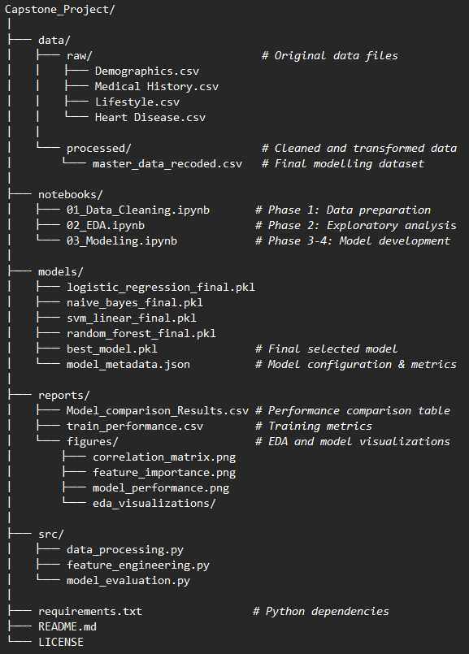




1.1 Technologies & Methodologies Used:
Page 3 of 15
The project follows a rigorous four-phase approach;
Project Folder Structure
Phase 1:
Phase 2:
Data Preparation & Cleaning
Exploratory Data Analysis(EDA)
Phase 3:
Phase 4:
Model Development
Model Evaluation & Comparison
The key tech stack applied in the analysis includes the following;
Core Languages & Frameworks
Python 3.10: Primary programming language
Jupyter Notebook: VSCode IDE
Data Manipulation & Analysis
pandas 2.0+: Data manipulation and analysis
NumPy 1.24+: Numerical computing
SciPy: Statistical functions
Machine Learning
scikit-learn 1.3+: Machine learning algorithms
Logistic Regression
Random Forest Classifier
Support Vector Machines
Naive Bayes
statsmodels: Statistical modeling (VIF calculation)
Data Visualization
Matplotlib 3.7+: Static plotting
Seaborn 0.12+: Statistical visualizations
Model Persistence
joblib: Model serialization
Utilities
pathlib: File path operations
json: Metadata storage

Slide 4











PHASE 1: Data Management & Preliminary Analysis
Page 4 of 15
Project Objective
Original Multiple Datasets
Analyze factors associated with heart disease and develop a robust predictive model to understand risk factors and improve early intervention.
Demographics
Medical History
5 variables, 319,795 records
9 variables, 319,795 records
Data Consolidation
Behaviour
Heart Disease
Four datasets merged using patient ID (pid):
6 variables, 319,795 records
2 variables, 319,795 records
Demographics (5 variables)
Behaviour (6 variables)
Medical History (9 variables)
Final Merged Dataset
Heart Disease (2 variables)
Records: 319,795
Feature Engineering
Variables: 19
Data Quality
Target: HeartDisease
Clean & Complete
Binary recoding of 'Yes/No' variables
Ordinal encoding for age categories
Categorical binning for BMI and sleep time
One-hot encoding for race variable

Slide 5



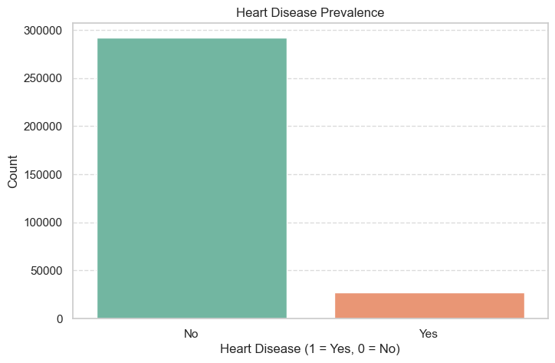







P1 Cont/…Heart Disease Distribution & Class Imbalance
Page 5 of 15
Heart Disease Distribution
Class Imbalance Challenge
The dataset exhibits a significant class imbalance:
Heart Disease (1)
27,373 records (8.56%)
No Heart Disease (0)
292,422 records (91.44%)
Impact on Model Evaluation
Affects model performance metrics
Can lead to overfitting for majority class
Impacts sensitivity and specificity
Requires careful evaluation techniques
Total Records
Heart Disease Rate
319,795
8.56%

Slide 6




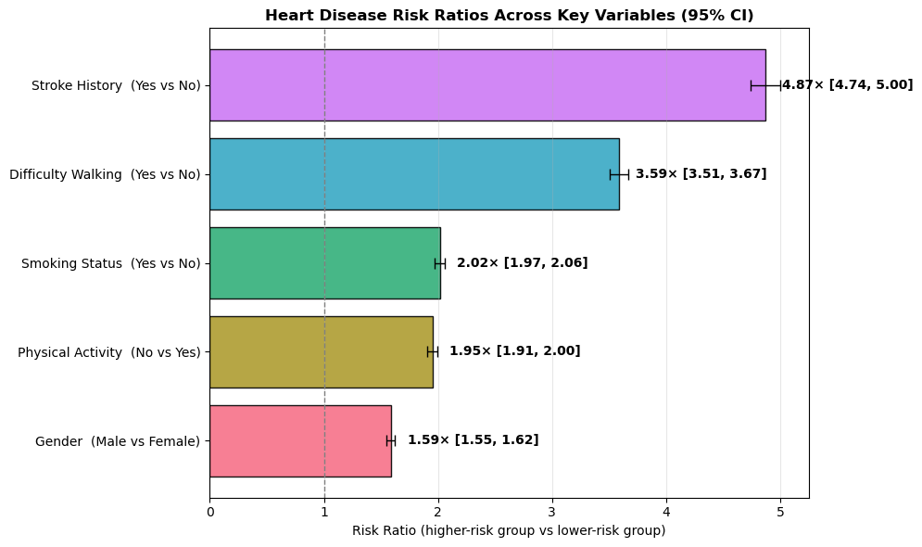







PHASE 2: EDA & Key Risk Factors Analysis
Page 6 of 15
Significant Risk Associations
Risk Ratio Comparison
Stroke History
Heart disease rate: 36.4% vs 7.5%
4.9× higher risk
Diabetes
Heart disease rate: 20.9% vs 6.5%
3.2× higher risk
Difficulty Walking
Heart disease rate: 22.6% vs 6.3%
3.6× higher risk
Smoking
Heart disease rate: 12.2% vs 6.0%
2.0× higher risk

Slide 7




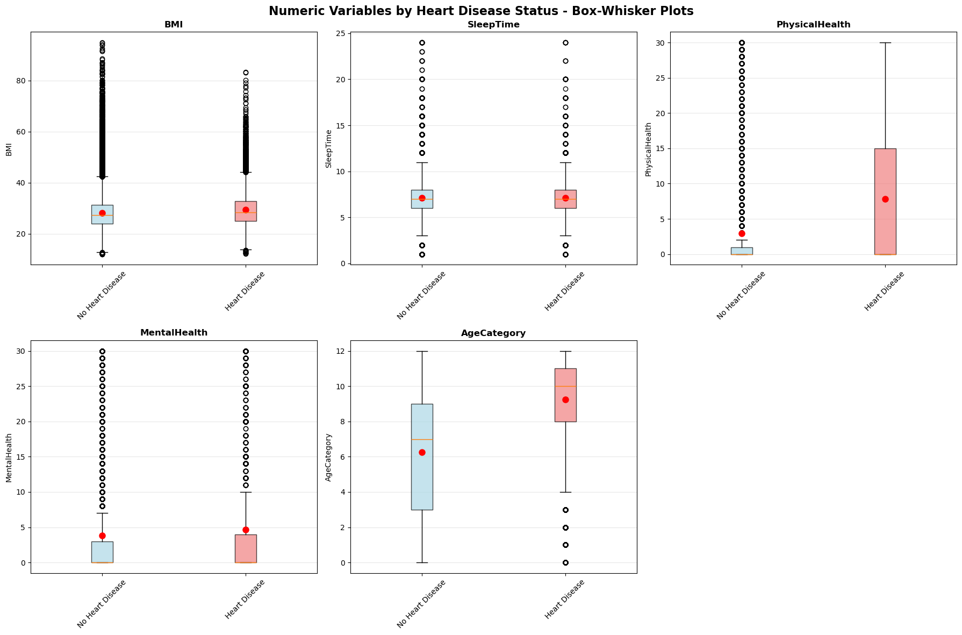





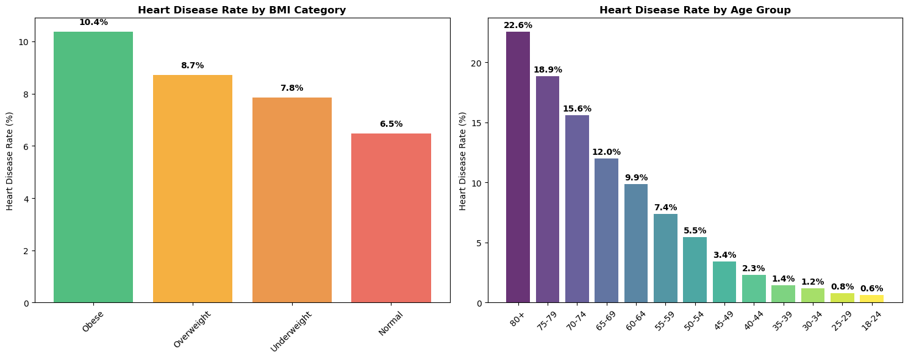



P2 Cont/… Demographic & Health Metrics Impact
Page 7 of 15
Analysis of numeric variables shows clear relationships with heart disease risk, with age and BMI exhibiting the strongest associations.
Age
Distribution of Health Metrics
Consistent increase in heart disease rates with advancing age, from 0.6% in younger adults to over 20% in older adults.
BMI
Obese category shows consistently highest heart disease rates (10.4%), followed by overweight (8.7%), normal weight (6.5%), and underweight (7.8%).
Physical Health
Heart Disease Rates by Category
Poorer physical health scores correlate with higher heart disease rates, with a clear distinction between categories.
Mental Health
Some association with heart disease risk, though less pronounced than physical health factors.
Key Insight: Age and BMI show the most consistent association with heart disease risk across the population.

Slide 8


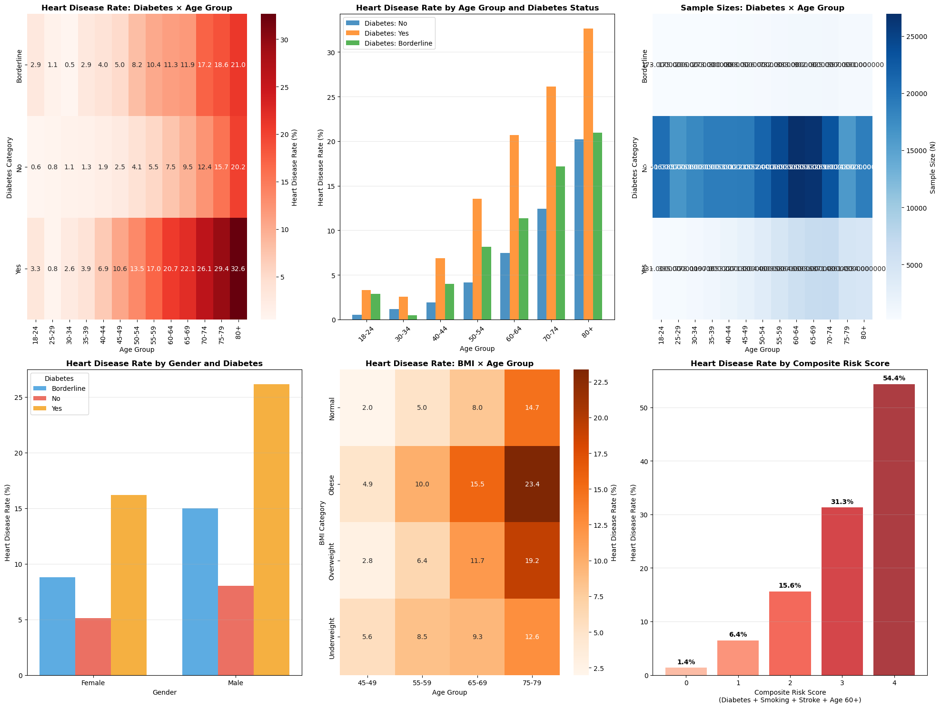

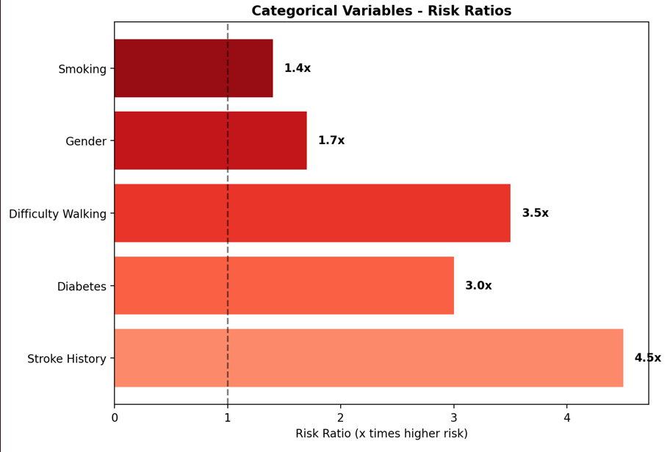
P2 Cont/… Interaction Effects & Compounding Risk
Page 8 of 15
Analysis reveals that combinations of risk factors significantly amplify heart disease risk beyond individual factors.
Key Insights
Individuals with 4+ risk factors have over 10x higher risk compared to those with no risk factors
The combination of diabetes and smoking shows a compounding effect on risk
Age 60+ combined with other factors creates a particularly high-risk profile
Composite Risk Score
A simple risk score was created by summing binary risk factors (Diabetes, Smoking, Stroke, Age 60+). The heart disease rate increased exponentially with this score, from ~3% with 0 risk factors to over 30% with 4 or more factors.

Slide 9




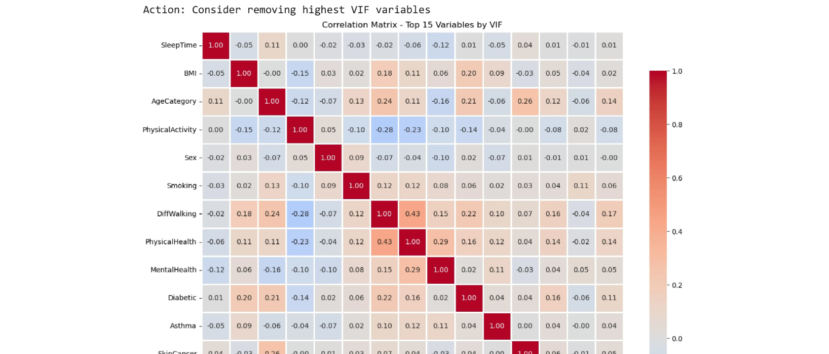





















PHASE 3: Predictive Modeling Approach
Page 9 of 15
Model Development Methodology
Multicollinearity Assessment
Train-Test Split
80/20 split with stratification to maintain class proportions
Multicollinearity Assessment
Variance Inflation Factor (VIF) analysis identified SleepTime (VIF=14.87) as problematic
Threshold Optimization
Used Youden's Index to balance sensitivity (80.25%) and specificity (70.61%)
Correlation matrix showing variables with high VIF values
Model Development Flow
Model Evaluation
Comprehensive assessment using AUC (0.8291 training, 0.8262 test)
Data Preparation
Feature Selection
Model Training
Deployment
Challenge Addressed
Key Insight
Class imbalance (8.56% heart disease cases) and multicollinearity
Random Forest emerged as the best-performing model with an AUC of 0.8269 on test data

Slide 10



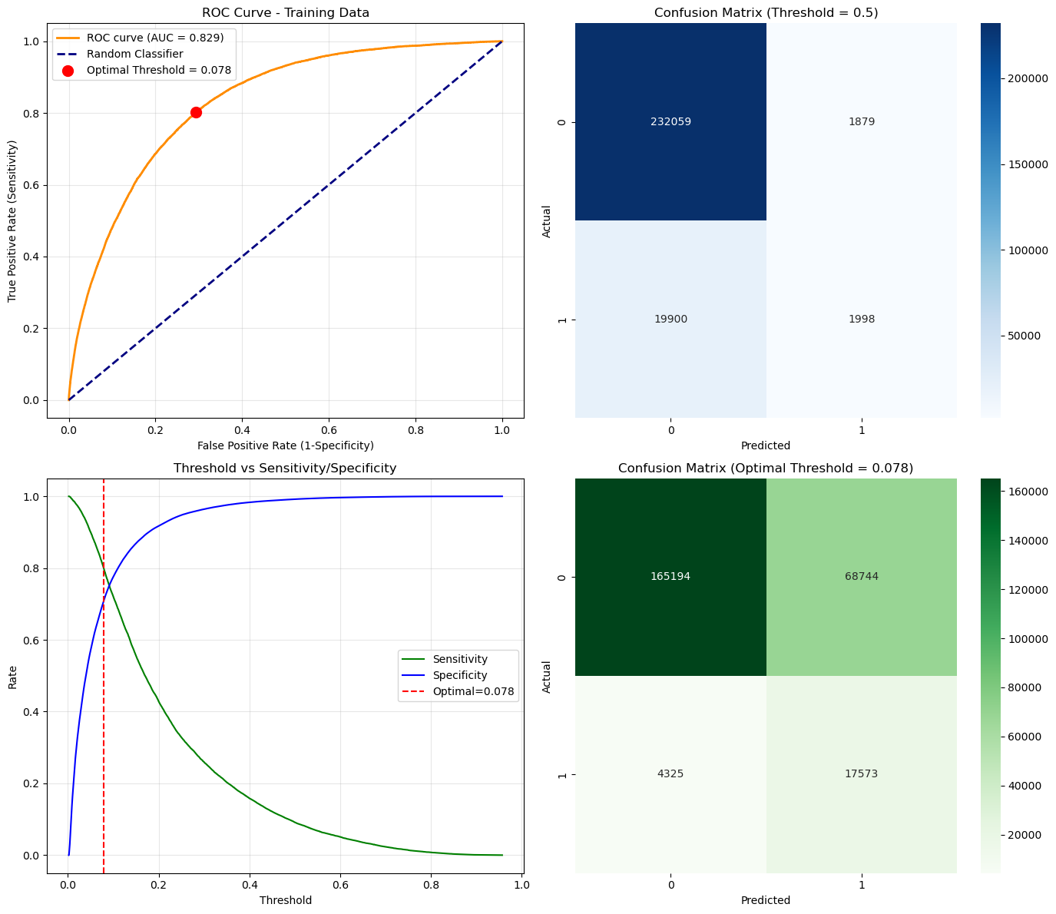









P3 Cont/…Predictive Models Development
Page 10 of 15
Logistic Regression Methodology
80/20 train-test split (stratified)
ROC Curve Analysis
Removed multicollinearity (VIF=14.87 for SleepTime)
14 statistically significant predictors (p < 0.001)
Threshold Optimization
Default threshold (0.5):
Sensitivity
Specificity
9.12%
99.20%
Optimal threshold (0.0782):
Sensitivity
Specificity
80.25%
70.61%
The initial high accuracy is misleading, driven by correctly classifying the majority "No Disease" class. The sensitivity of 9.12% is unacceptable for a medical screening tool. Optimal Threshold Selection Using Youden's Index (maximizing Sensitivity + Specificity), the optimal threshold was found to be 0.0782.
Model Performance
Training AUC
Test AUC
0.8291
0.8262
Accuracy
Overfitting
71.44%
0.0324

Slide 11


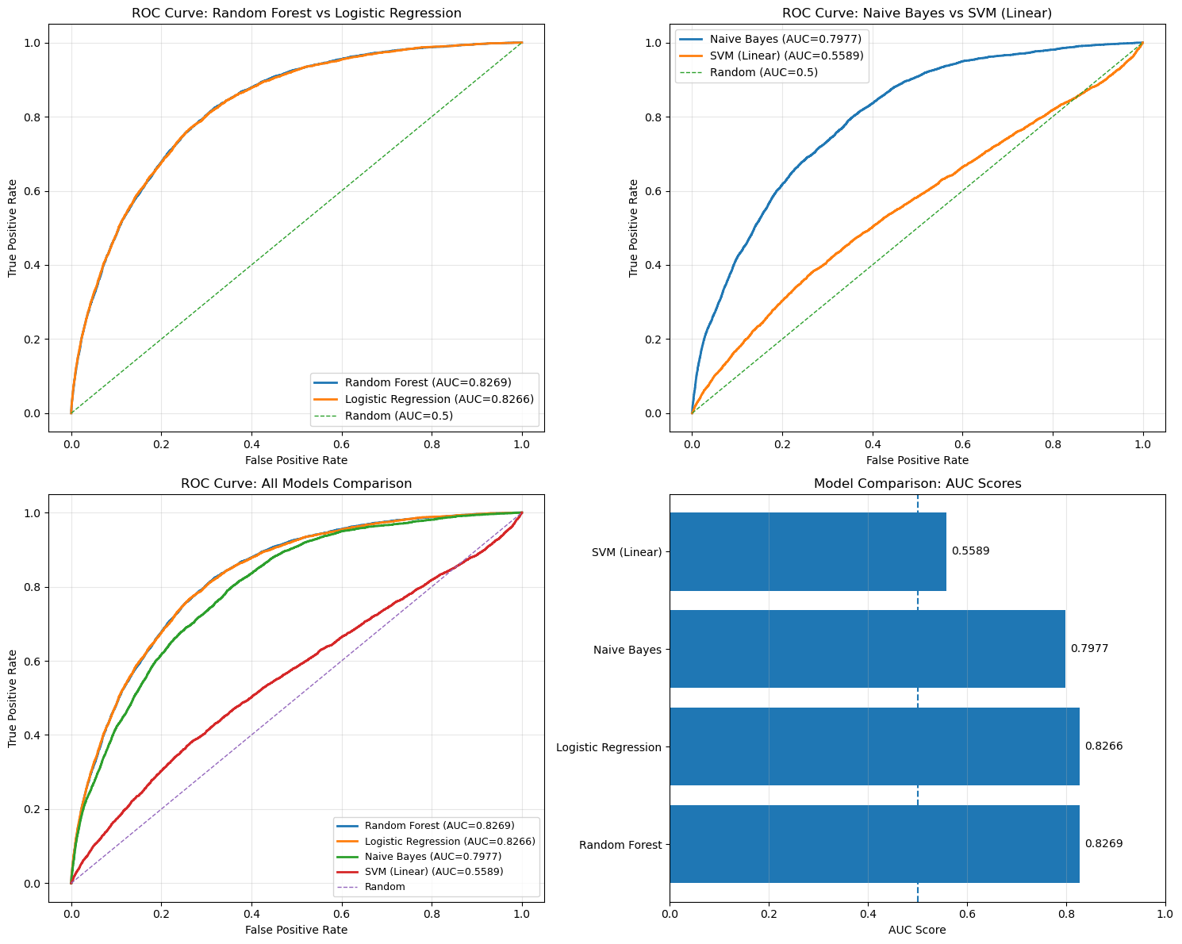














PHASE 4: Machine Learning Model Comparison ROC Curve Analysis
Page 11 of 15
Model Performance Comparison
Random Forest
AUC: 0.8269
Best overall performance with excellent balance across metrics.
Logistic Regression
AUC: 0.8266
Strong baseline model with interpretable results.
Naïve Bayes
AUC: 0.7977
Slightly lower performance but still effective.
SVM (Linear)
AUC: 0.5589
Competitive but slower training time.
ROC Curve Insights
ROC curves illustrate the diagnostic ability of a binary classifier system as the discrimination threshold is varied. The area under the ROC curve (AUC) provides a single measure of overall classifier performance.

Slide 12


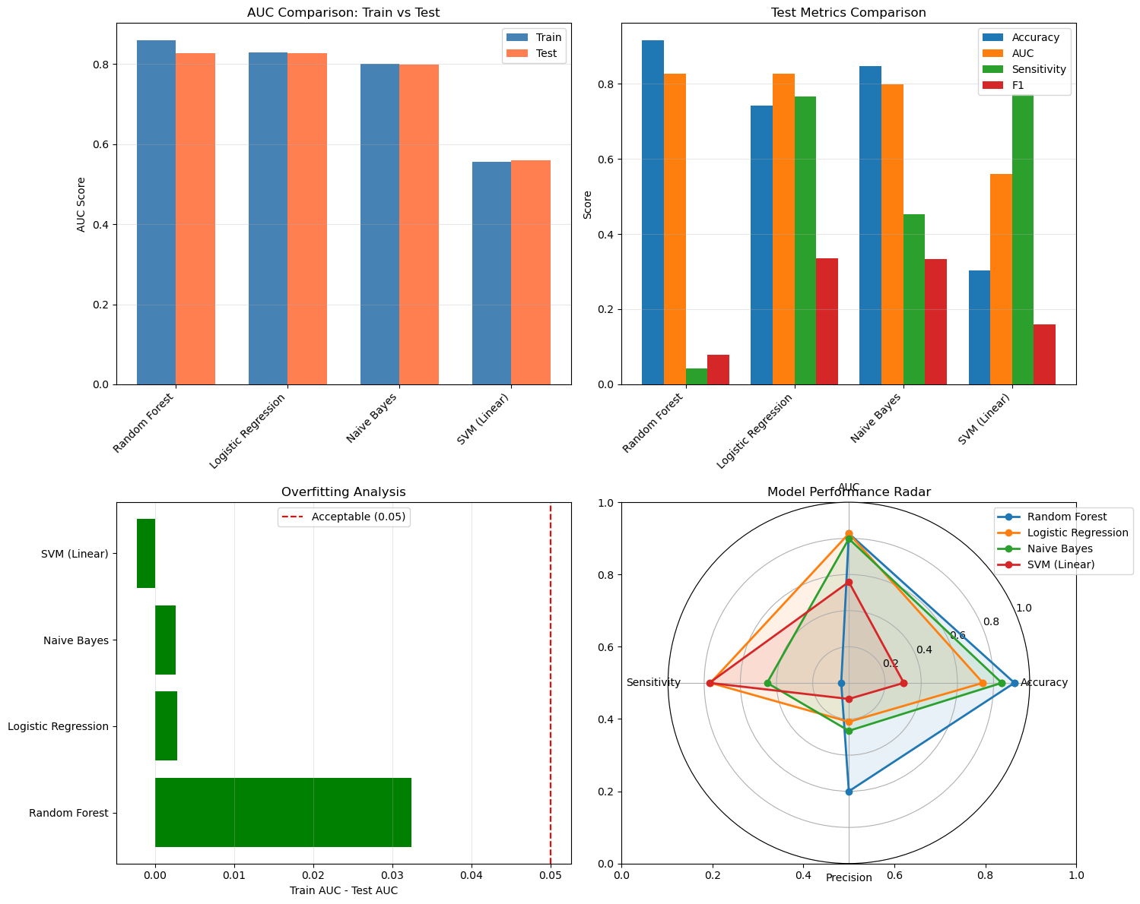




P4 Cont/…Model Comparison & Selection
Page 12 of 15
Model Performance Comparison
Best Model: Random Forest
Random Forest
BEST MODEL
Test AUC
Overfitting
0.8269
0.0324
Accuracy
Sensitivity
0.9156
0.0422
Selection Criteria
Highest Test AUC: Random Forest (0.8269)
Lowest Overfitting: Random Forest (0.0324)
Balance of Accuracy, Sensitivity, and Precision

Slide 13
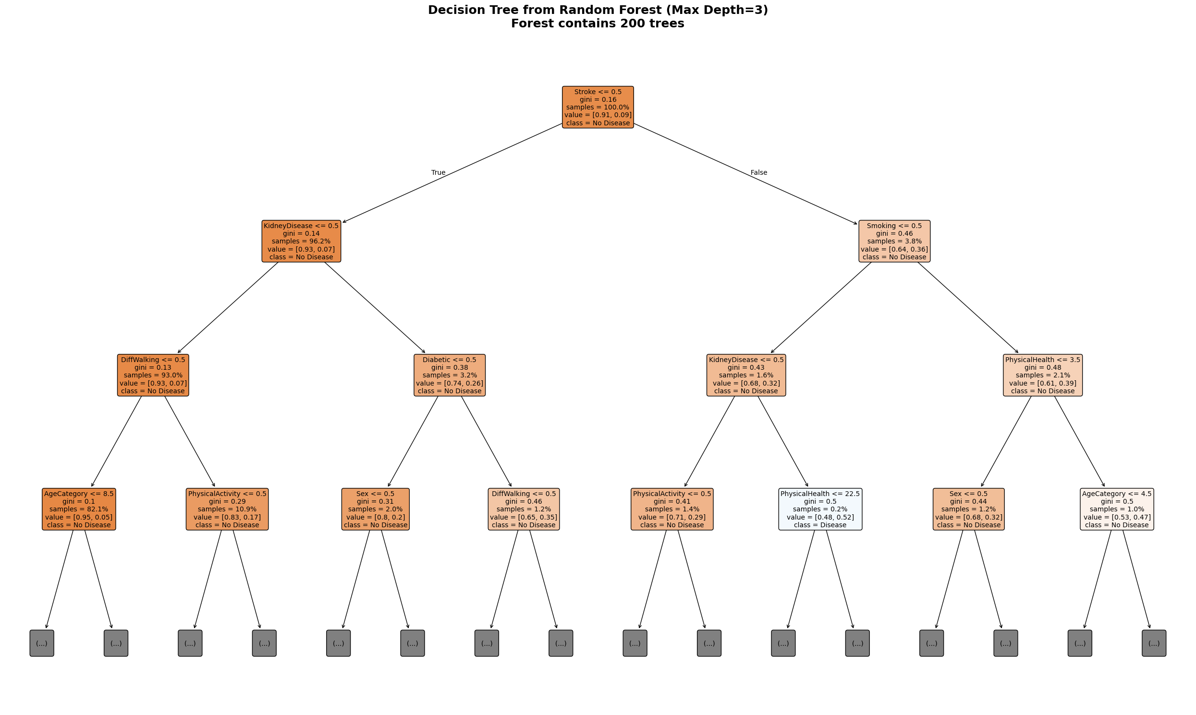
P4 Cont/… Model Selection Rationale
Page 13 of 15
Reasons for Selection
Trade-off: The primary weakness of the Random Forest model is its very low sensitivity (4.22%) when using default settings. However, for a deployment scenario, the probability scores it generates can be used with the optimized threshold (0.0782) discovered during the Logistic Regression phase, which would restore high sensitivity. The Random Forest's strength lies in its superior ranking of instances (high AUC).

Slide 14





















Key Summary Findings & Recommendations
Page 14 of 15
Key Findings
Recommendations
Stroke History: 4.9x higher risk
Deployment Plan
Deploy Random Forest model into a real-time prediction dashboard
Diabetes: 3.2x increased risk
Used Streamlit for the dashboard implementation click HERE
Gender: Males have 1.6x higher risk
Target healthcare professionals for clinical decision support
Physical Activity: Protective factor
Expected Benefits
Best Model Performance: Random Forest
Early intervention
Patient care
Test AUC
Accuracy
Precision
0.8269
0.9156
0.6000
Improved outcomes
Resource optimization

Slide 15

Conclusion
Page 15 of 15
Summary and Recommendations
This project successfully identified the key factors associated with heart disease and developed a high-performing predictive model.
Top Risk Factors: Stroke History, Diabetes, Kidney Disease, Difficulty Walking, and Smoking.
Protective Factors: Physical Activity and moderate Alcohol Consumption.
Demographics: Risk increases significantly with age and is higher in males.
Compounding Risk: Combinations of factors (e.g., Diabetes and Old Age) lead to exponentially higher risk.
Best Model: The Random Forest algorithm provided the most powerful predictions (AUC: 0.8269).
STRATEGIC RECOMMENDATIONS
Clinical Deployment: Created and deployed the finalized Random Forest model into a user-friendly Streamlit dashboard. This will allow healthcare professionals to input patient data and receive an immediate, evidence-based heart disease risk score.
Preventive Health Focus: Public health initiatives should prioritize managing conditions like diabetes and hypertension, and promoting physical activity, as these are major, modifiable risk factors.
Screening Programs: The model can be integrated into routine health screenings to flag high-risk patients for further diagnostic testing, enabling earlier intervention.

